Slide 1

SOFTWARE ENGINEERING AND PROJECT MANAGEMENT (CSE 227)
Department of Computer Science and Engineering
School of Engineering,
PRESIDENCY UNIVERSITY

Slide 2
Module 4: Software Project Management (13 hrs) – Application level
Project Management Concepts, Project Planning, Overview of metrics, Estimation for Software projects, Project Scheduling, Risk Management, Maintenance and Reengineering, Software Process Improvement (SPI): CMM Levels.

Slide 3
Project Scheduling
Department of Computer Science and Engineering
School of Engineering, Presidency University

Slide 4
Why are Projects Late?
an unrealistic deadline established by someone outside the software development group
changing customer requirements that are not reflected in schedule changes;
an honest underestimate of the amount of effort and/or the number of resources that will be required to do the job;
predictable and/or unpredictable risks that were not considered when the project commenced;
technical difficulties that could not have been foreseen in advance;
human difficulties that could not have been foreseen in advance;
miscommunication among project staff that results in delays;
a failure by project management to recognize that the project is falling behind schedule and a lack of action to correct the problem

Slide 5
What is Project Scheduling?
Project scheduling is a mechanism to communicate what tasks need to get done and which organizational resources will be allocated to complete those tasks in what timeframe.
Three important parameters to be considered for Scheduling:
Tasks to be completed
Timeframe for completion of the tasks
Resources who will work on the tasks

Slide 6
Scheduling Principles
Compartmentalization - define distinct tasks
Interdependency - indicate task interrelationship
Effort validation - be sure resources are available
Defined Responsibilities - people must be assigned
Defined Outcomes - each task must have an output
Defined Milestones - review for quality

Slide 7
Effort and Delivery Time

Slide 8
Typical Effort Allocation across different Project Activities
“front end” activities
customer communication
analysis
design
review and modification
construction activities
coding or code generation
testing and installation
unit, integration
white-box, black box
regression
40-50%
15-20%
30-40%

Slide 9
Gantt Chart
A Gantt chart is a horizontal bar chart developed as a production control tool in 1917 by Henry L. Gantt, an American engineer and social scientist. Frequently used in project management, a Gantt chart provides a graphical illustration of a schedule that helps to plan, coordinate, and track specific tasks in a project.

Slide 10
Creating a Gantt Chart to depict Project Schedule
Steps:
Create Project Tasks - Assign start date, duration, priority
Create Project Milestones - A project milestone is a task of zero duration that shows an important achievement in a project.
Organize tasks in a work breakdown structure.
Create and Assign Resources to Tasks
Draw Dependency Constraints on Tasks

Slide 11
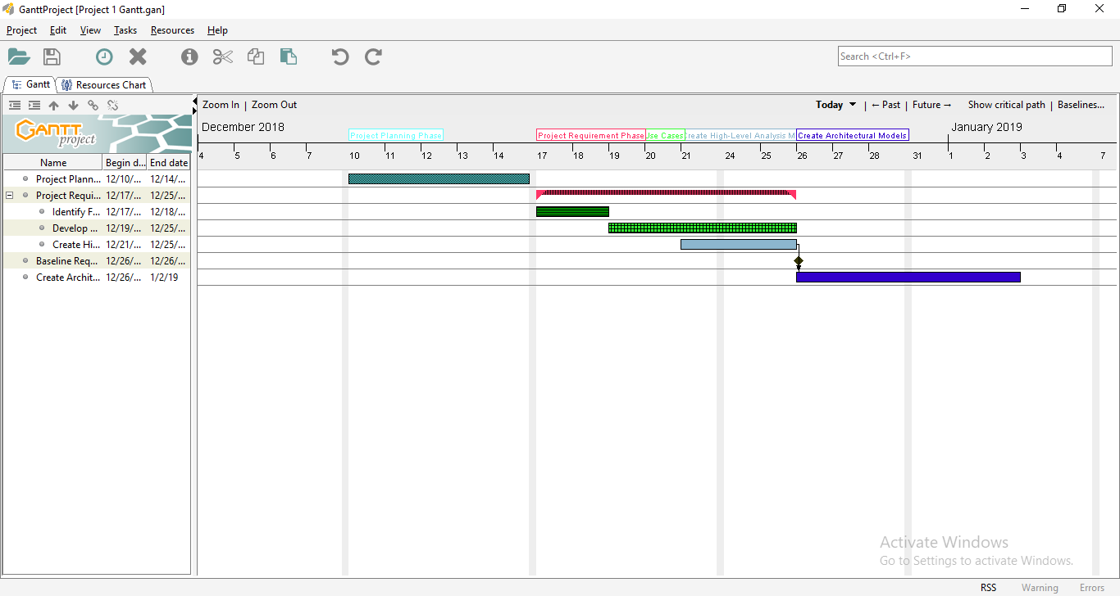
Demo of Gantt Chart using “Gantt Project” software

Slide 12
Schedule Tracking
Conduct periodic project status meetings in which each team member reports progress and problems.
Evaluate the results of all reviews conducted throughout the software engineering process.
Determine whether formal project milestones have been accomplished by the scheduled date.
Compare actual start-date to planned start-date for each project task listed in the Gantt chart
Meet informally with project members to obtain their subjective assessment of progress to date and problems on the horizon.
Use earned value analysis to assess progress quantitatively.

Slide 13
Earned Value Analysis (EVA)
Earned value
is a measure of progress
enables us to assess the “percent of completeness” of a project using quantitative analysis rather than rely on a gut feeling
“provides accurate and reliable readings of performance from as early as 15 percent into the project.”

Slide 14
Computing Earned Value-I
The budgeted cost of work scheduled (BCWS) is determined for each work task represented in the schedule.
BCWS_{i} is the effort planned for work task i.
To determine progress at a given point along the project schedule, the value of BCWS is the sum of the BCWS_{i} values for all work tasks that should have been completed by that point in time on the project schedule.
The BCWS values for all work tasks are summed to derive the budget at completion, BAC. Hence,
BAC = ∑ (BCWS_{k}) for all tasks k

Slide 15
Computing Earned Value-II
Next, the value for budgeted cost of work performed (BCWP) is computed.
The value for BCWP is the sum of the BCWS values for all work tasks that have actually been completed by a point in time on the project schedule.
“the distinction between the BCWS and the BCWP is that the former represents the budget of the activities that were planned to be completed and the latter represents the budget of the activities that actually were completed.” [Wil99]
Given values for BCWS, BAC, and BCWP, important progress indicators can be computed:
Schedule performance index, SPI = BCWP/BCWS
Schedule variance, SV = BCWP – BCWS
SPI is an indication of the efficiency with which the project is utilizing scheduled resources.

Slide 16
Computing Earned Value-III
Percent scheduled for completion = BCWS/BAC
provides an indication of the percentage of work that should have been completed by time t.
Percent complete = BCWP/BAC
provides a quantitative indication of the percent of completeness of the project at a given point in time, t.
Actual cost of work performed, ACWP, is the sum of the effort actually expended on work tasks that have been completed by a point in time on the project schedule. It is then possible to compute
Cost performance index, CPI = BCWP/ACWP
Cost variance, CV = BCWP – ACWP

Slide 17
Case Study to create Gantt Chart – Hospital Construction Project
Activity | Description | Predecessors | Duration (Weeks)
A | Select administrative and medical staff. | - | 12
B | Select site and do site survey. | - | 9
C | Select equipment. | A | 10
D | Prepare final construction plans and layout. | B | 10
E | Bring utilities to the site. | B | 24
F | Interview applicants and fill positions in nursing support staff, maintenance, and security. | A | 10
G | Purchase and take delivery of equipment. | C | 35
H | Construct the Hospital | D | 40
I | Develop an information system | A | 15
J | Install the Equipment | E,G,H | 4
K | Train nurses and support staff | F,I,J | 9

Slide 18
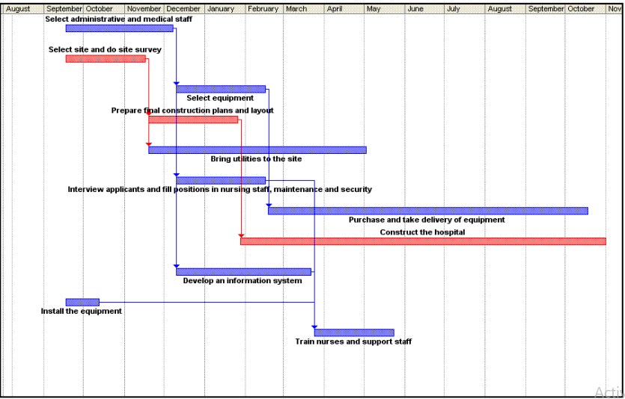
Gantt Chart for the Case

